Slide 1
Predicting Winners in the Eurovision Song Contest
Anna-Ilona Nikolaeva
Tim Kicker
Yauheni Zviazdou

Slide 2
Motivation: analyze Eurovision trends, to
Support decisions for prediction market users.
Insights for contestants.
Greater transparency in Eurovision trends in winners
Improved strategic decision-making for all parties.

Slide 3
Dataset, what we collected
We used half of the data from year 1956 and half from the 2008, as following:
Dataset / Chart | Coverage
Age & Gender | 1956–2026
Running Order & Countries | 1956–2026
Language & Lyrics | 2008–2026
Google Search trends (how popular searches for songs were the day before the competition) | 2008–2026
Distance, border and languages of voting countries | All participant countries

Slide 4
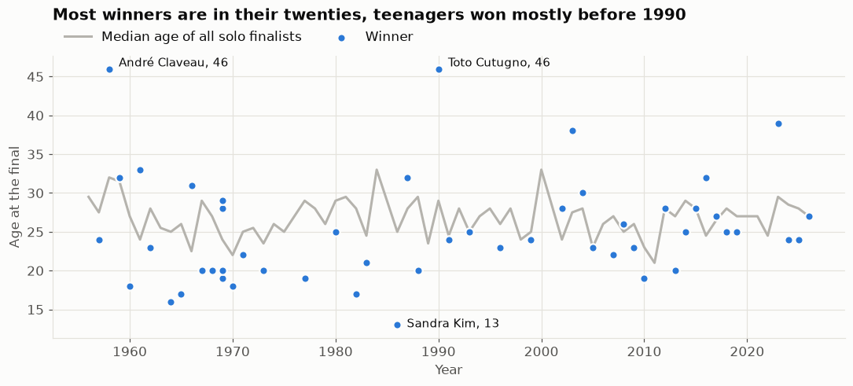
Visualisations: Winner’s Age

Slide 5
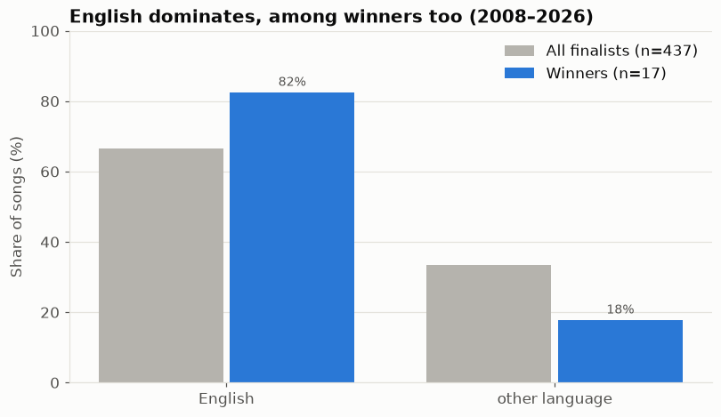
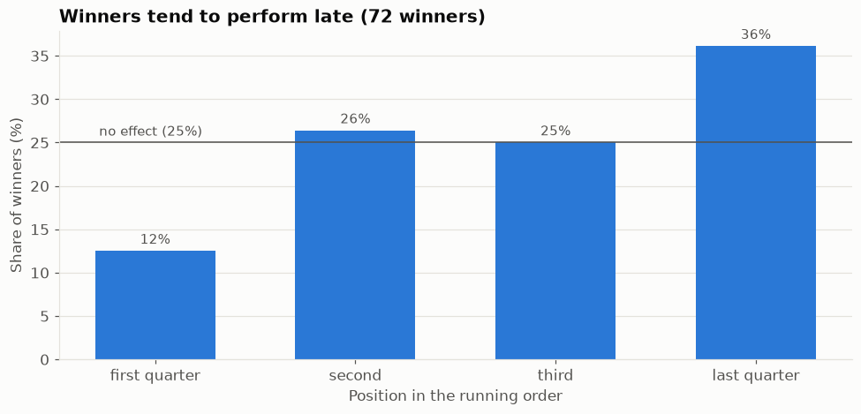
Visualisations: Song Language (left) and Running Order (right)

Slide 6
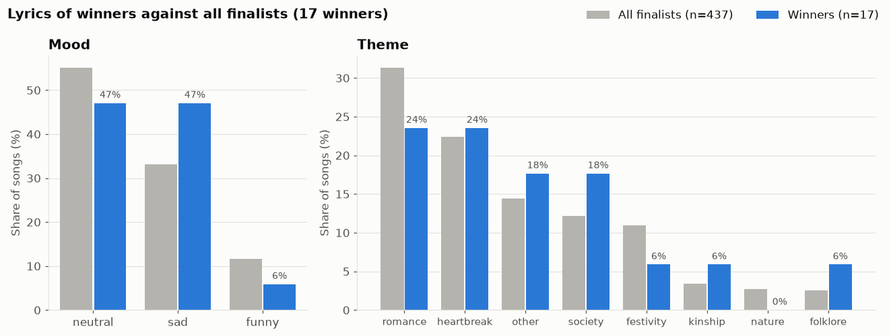
Visualisations: Lyrics

Slide 7
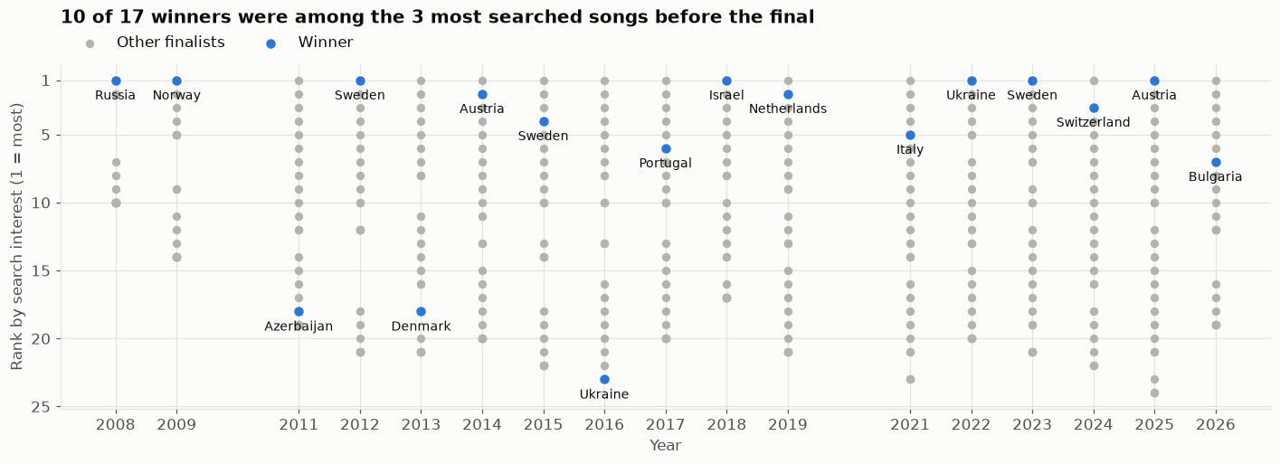
Visualisations: Google Searches

Slide 8
Prediction results: which factors matter
We first explored which factors actually matter:
Past points, web interest and running position usually achieved high scores,
and
Neutral lyrics sentiment tended to receive lower scores. Also longer distance between voting countries negatively influenced scoring between them.

Slide 9
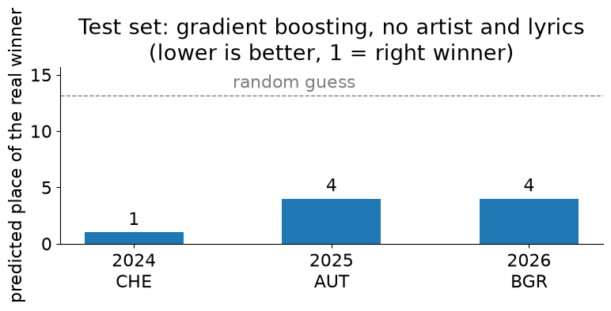
Prediction results: test set
Top model predicted unseen event winners using exclusively training and validation data.

Slide 10
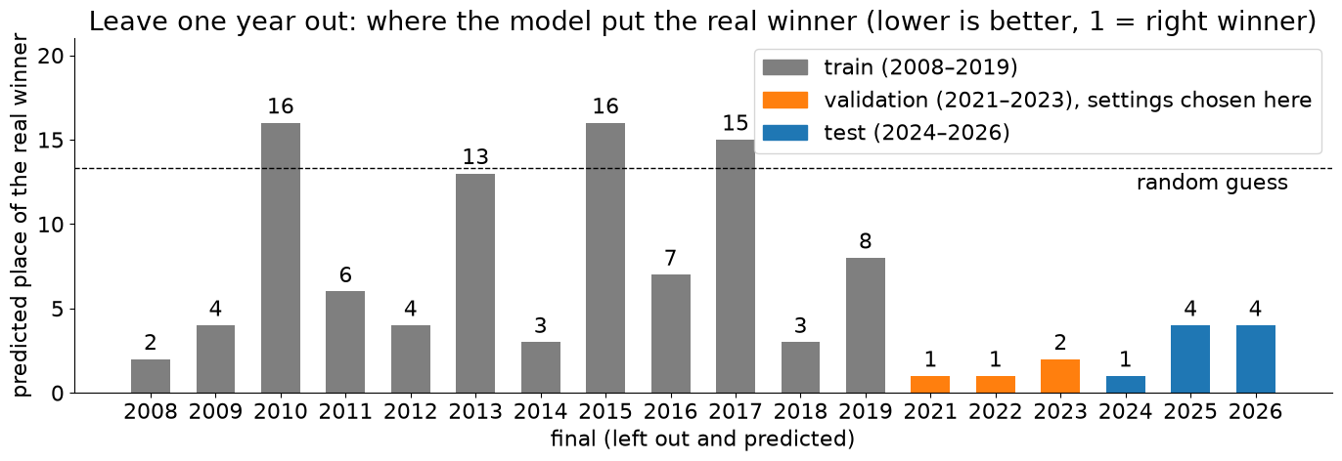
Prediction results: one year out

Slide 11
Future improvements
Better model for predictions (neural network)
Processing actual video clips of songs
Better recognition of lyrics sentiment
Other trends informations (Twitter? :))

Slide 12
Thank you!😊

Slide 13
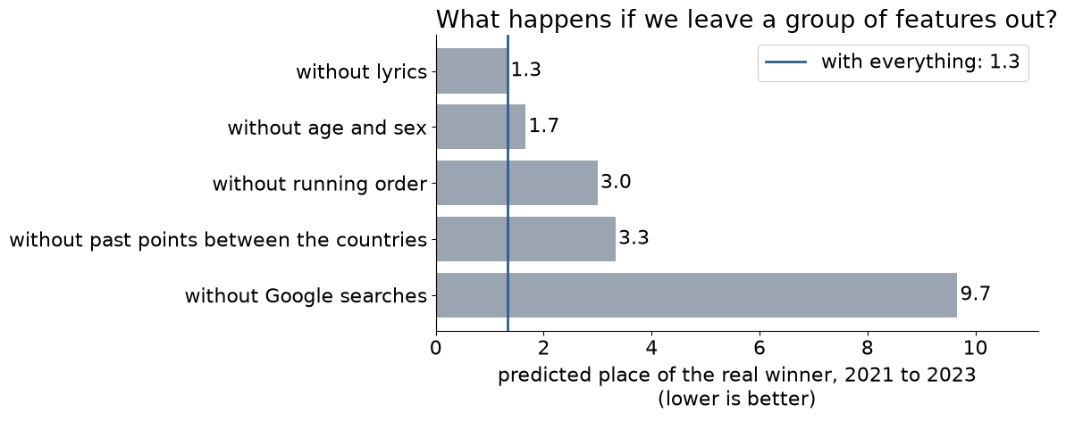
Prediction results: which factors matter

Slide 14
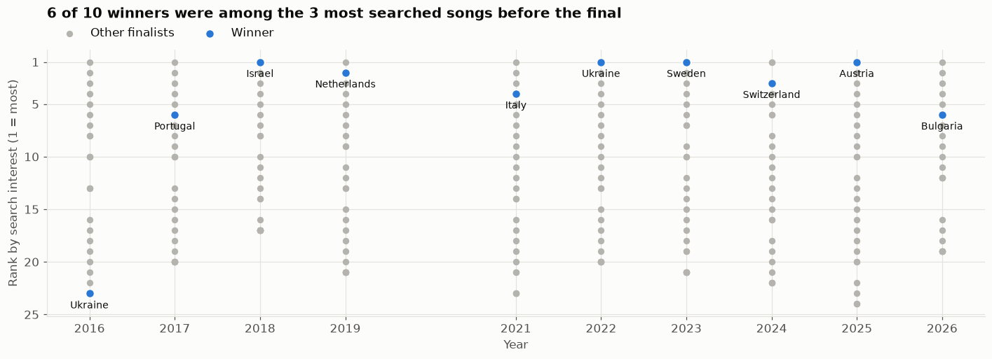
Visualisations: Google Searches

